Slide 1
ICOs vs Cryptokitties
An introduction to fungible and not fungible assets on blockchain (ERC20 vs ERC 721) with an accent on Ethereum scalability issues
Stefano Leone, Chief Technology Officer @ Deloitte Blockchain Lab Italy

Slide 2
Contents
Ethereum Governance 3
ICO Tokens 7
KryptoKitties 9
Ethereum scalability 11
References 15

Slide 3
Ethereum Governance
EIP & ERC

Slide 4
Ethereum Governance
What is an EIP?
EIP stands for Ethereum Improvement Proposal.
An EIP is a design document providing information to the Ethereum community, or describing a new feature for Ethereum or its processes or environment.

Slide 5
Ethereum Governance
EIP types
There are three types of EIP:
A Standard EIP describes any change that affects most or all Ethereum implementations, such as a change to the the network protocol, a change in block or transaction validity rules, proposed application standards/conventions.
Core - improvements requiring a consensus fork or may be relevant to core dev discussions
Networking - includes improvements to network protocol specifications (ex. Whisper and swarm)
Interface - includes improvements around client API/RPC specifications and standards
ERC - application-level standards and conventions, including contract standards such as token standards, name registries, URI schemes, library/package formats, and wallet formats
An Informational EIP describes an Ethereum design issue, or provides general guidelines or information to the Ethereum community
A Meta EIP describes a process surrounding Ethereum or proposes a change to (or an event in) a process. Process EIPs are like Standards Track EIPs but apply to areas other than the Ethereum protocol itself.

Slide 6
Ethereum Governance
EIP process
Someone submits a draft EIP as a Pull Request
Interested participants debate the proposal until consensus on the contents of the draft have been reached.
An EIP editor merges the PR as a draft
Someone submits a PR to update the draft; repeat from step 2.
Once the EIP is 'mature', if it modifies the protocol it's discussed at an All Core Devs meeting. If the participants agree it's a good idea, they implement it in their specific clients, and the EIP moves to 'accepted'.
Once implemented, if the EIP modifies consensus, it's added to a scheduled hard fork.
The hard fork and its contents are announced, and users have the opportunity to determine if they accept the hard fork or reject it.
The hard fork block is reached, and people upgrade, or don't.

Slide 7
ICO Tokens
ERC20

Slide 8
ICO Tokens
ERC-20 Token Standard (FINAL)
Motivation
A standard interface allows any tokens on Ethereum to be re-used by other applications: from wallets to decentralized exchanges.
Mandatory Methods
function totalSupply() view returns (uint256 totalSupply)
function balanceOf(address _owner) view returns (uint256 balance)
function transfer(address _to, uint256 _value) returns (bool success)
function transferFrom(address _from, address _to, uint256 _value) returns (bool success)
function approve(address _spender, uint256 _value) returns (bool success)
function allowance(address _owner, address _spender) view returns (uint256 remaining)
Optional Methods
function name() view returns (string name)
function symbol() view returns (string symbol)
function decimals() view returns (uint8 decimals)
Events
event Transfer(address indexed _from, address indexed _to, uint256 _value)
event Approval(address indexed _owner, address indexed _spender, uint256 _value)

Slide 9
KriptoKitties
ERC721

Slide 10
KriptoKitties, CryptoPunks, Dmarket, Propy
ERC-721 Non-Fungible Token Standard (DRAFT)
Motivation
A standard interface allows wallet/broker/auction applications to work with any NFT on Ethereum.
This standard is inspired by the ERC-20 token standard. EIP-20 is insufficient for tracking NFTs because each asset is distinct (non-fungible) whereas each of a quantity of tokens is identical (fungible).
NTF IDs
The basis of this standard is that every NFT is identified by a unique, 256-bit unsigned integer within its tracking contract. This ID number MUST NOT change for the life of the contract. The pair (contract address, asset ID) will then be a globally unique and fully-qualified identifier for a specific NFT within the Ethereum ecosystem.
Mandatory Methods
function totalSupply() view returns (uint256 totalSupply)
function balanceOf(address _owner) view returns (uint256 balance)
function ownerOf(uint256 _tokenId) view returns (address owner)
function transfer(address _to, uint256 _value) returns (bool success)
function takeOwnership(uint256 _tokenId)
function approve(address _to, uint256 _tokenId)
Optional Methods
function name() view returns (string name)
function symbol() view returns (string symbol)
function tokenOfOwnerByIndex(address _owner, uint256 _index) view returns (uint tokenId)
Events
event Transfer(address indexed _from, address indexed _to, uint256 _tokenId)
event Approval(address indexed _owner, address indexed _approved, uint256 _tokenId)

Slide 11
Ethereum scalability
Issues & Solutions

Slide 12
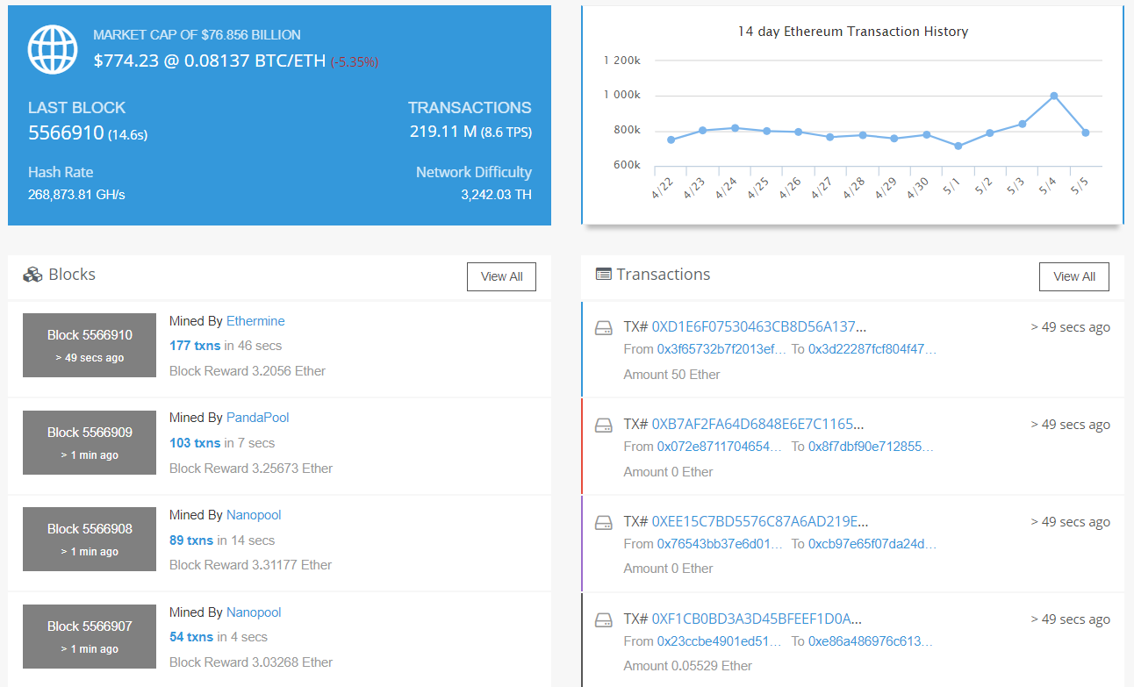
Ethereum Scalability
Why doesn’t Ethereum scale (yet)?

Slide 13
Ethereum Scalability
On-chain solutions
Solution | Description | Status
Increase Gas Limit | Miners increase gas limit | Adopted
Parallel process transactions | Transactions say "I will touch these accounts/contracts and no others. Miners can execute transactions in parallel as long as they don't modify the same accounts/contracts | Concept
WASM | WebAssembly (wasm, WA) is a web standard that defines a binary format and a corresponding assembly-like text format for executable code in Web pages | In progress
Proof of Stake | the creator of the next block is chosen via various combinations of random selection and wealth | Hybrid PoS in TESTNET

Slide 14
Ethereum Scalability
Off-chain solutions
Solution | Description | Status
Payment Channel Networks | The Raiden Network is an off-chain scaling solution, enabling near-instant, low-fee and scalable payments. It’s complementary to the Ethereum blockchain and works with any ERC20 compatible token. | Raiden is working progress. µRaiden in on MAINNET
Truebit | Moves computation off-chain and verifies its correctness via an interactive crypteconomic protocol. | Work in progress
Plasma/Cash Plasma | Tree hierarchy of blockchains where only fraud proofs are reported up the tree | Work in progress
Sharding | Validators only need validate some, not all, of the network's transactions | Work in progress, recently added on GitHub

Slide 15
References

Slide 16
References
Ethereum Improvement Proposals
https://eips.ethereum.org
EIP 20: ERC-20 Token Standard
https://eips.ethereum.org/EIPS/eip-20
EIP 721: ERC-721 Non-Fungible Token Standard
https://eips.ethereum.org/EIPS/eip-721
CryptoPunks
https://www.larvalabs.com/cryptopunks
Dmarket
https://dmarket.com
Propy Real Estate
https://tokensale.propy.com
Ethereum block explorer
https://etherscan.io
Raiden Network
https://raiden.network
KriptoKitties
https://www.cryptokitties.co
Proof of Stake
https://github.com/ethereum/wiki/wiki/Proof-of-Stake-FAQ
WASM
http://webassembly.org
Sharding
https://github.com/ethereum/wiki/wiki/Sharding-FAQ

Slide 17
Thank You!
Stefano Leone
Deloitte Blockchain Lab Italy
www.meetup.com/Ethereum-Milano
www.linkedin.com/in/stefanoleone
sleone@deloitte.it

Slide 18
Deloitte refers to one or more of Deloitte Touche Tohmatsu Limited, a UK private company limited by guarantee (“DTTL”), its network of member firms, and their related entities. DTTL and each of its member firms are legally separate and independent entities. DTTL (also referred to as “Deloitte Global”) does not provide services to clients. Please see www.deloitte.com/about for a more detailed description of DTTL and its member firms.
This communication is for internal distribution and use only among personnel of Deloitte Touche Tohmatsu Limited, its member firms, and their related entities (collectively, the “Deloitte network”). None of the Deloitte network shall be responsible for any loss whatsoever sustained by any person who relies on this communication.
© 2016. For information, contact Deloitte Touche Tohmatsu Limited

