Slide 1
Firma convenzione Politecnico di Milano e Veneranda Fabbrica del Duomo di Milano
POLIMI Fintech Journey
From Blockchain&Bitcoin to Distributed Ledger Technologies, Smart Contracts and Cryptocurrencies
in Finance
The ICO market
Giancarlo Giudici
(Politecnico di Milano – School of Management)
Aula Magna – Rettorato
Mercoledì 27 maggio 2015

Slide 2
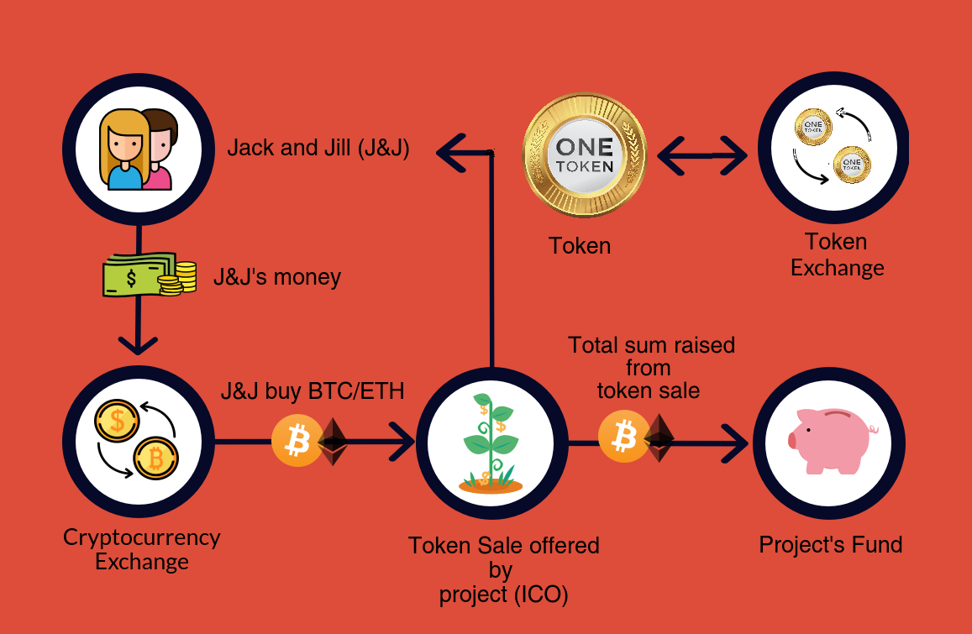
An ICO process
Cryptocurrencies allow us to pay… so why don’t we raise money through cryptocurrencies?
- The case of the DAO project
Virtually similar to a crowdfunding campaign…
Differences:
No third-party platform
No credit card / bank circuit to manage payments
2

Slide 3
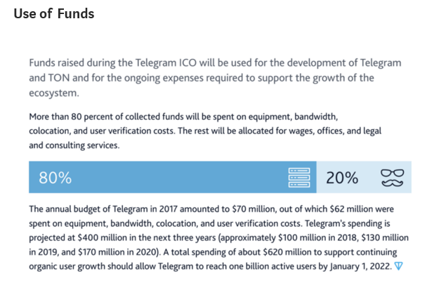
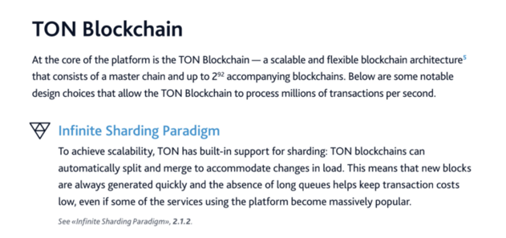
An ICO example
Cancelled
3

Slide 4
The hype in 2017
Claim: $ 5.3 billion raised
Source: Giudici and Adhami (2018)
4

Slide 5
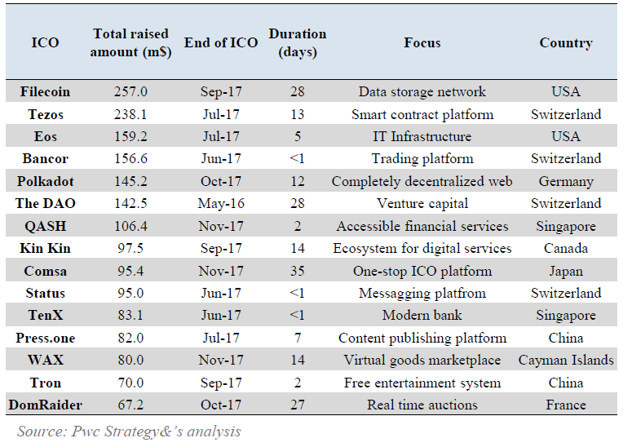
Most successful ICOs in 2017
5

Slide 6
ICO regulation around the world
Banned in China and South Korea(?) (as well as ads on big techs)
Watched in the US (‘Howey test’)
‘Wait-and-see’ in the EU (warning investors about risks)
Positive attitude in some countries (Gibraltar, Malta, Lithuania, Estonia, Switzerland, …) as to attract capital and startups
6

Slide 7
Italian ICOs
Cryptoforecast (April 2017) $ 194k
Eidoo (October 2017) $ 25M
FTB (October 2017) $ 50k
Popeie (Otober 2017) failed
MakeItViral (December 2017) failed
Robo Advisor Coin (December 2017) $ 175k
Demeter (December 2017) failed
7

Slide 8
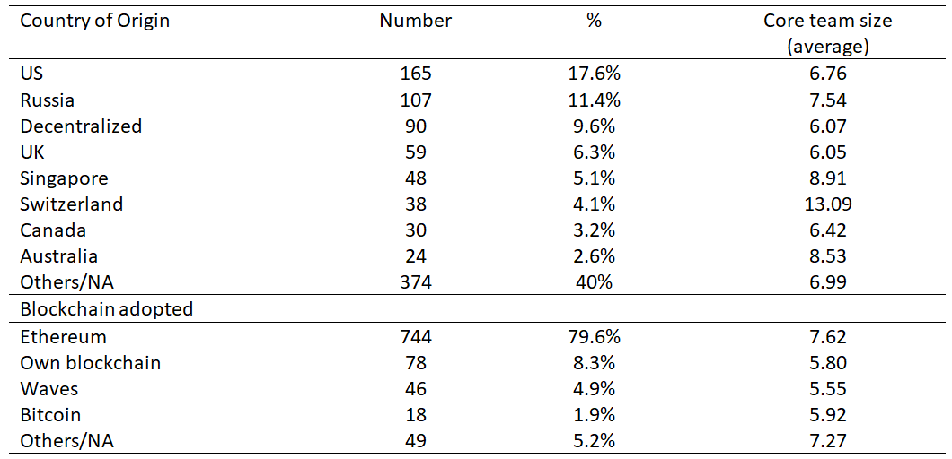
ICO characteristics (1/3)
Source: Giudici and Adhami (2018)
8

Slide 9
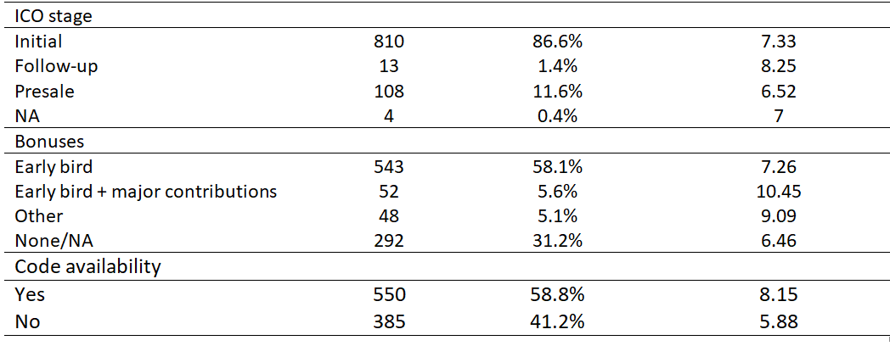
ICO characteristics (2/3)
Source: Giudici and Adhami (2018)
9

Slide 10
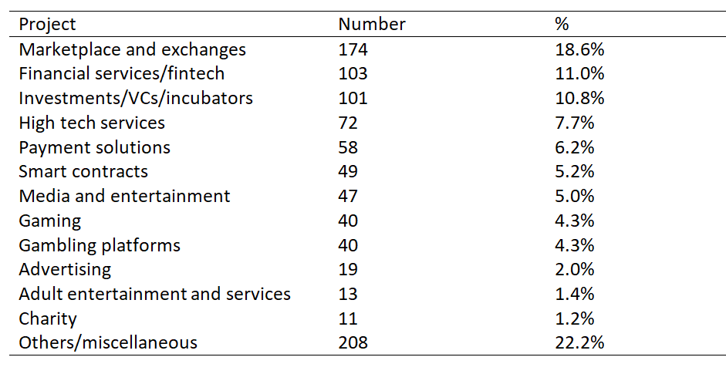
ICO characteristics (3/3)
Source: Giudici and Adhami (2018)
10

Slide 11
Token rights and market
Source: Giudici and Adhami (2018)
11

Slide 12
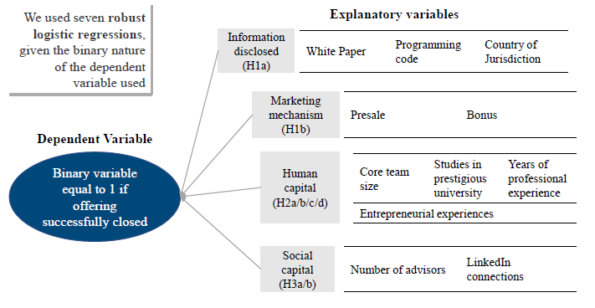
Determinants of the success
12

Slide 13
Determinants of the success: findings






13

Slide 14
Perspectives
As many other technology booms, ICOs experienced an initial hype (and many projects will be classified as ‘scam’).
Yet it is another step towards disintermediation of fundraising.
Smart contracts could be useful to implement typical provisions requested by investors and by entrepreneurs (i.e. tag along and drag along rights, veto power, liquidation preferences, carried interest).
Regulation and transparency are needed.
14

Slide 15
Firma convenzione Politecnico di Milano e Veneranda Fabbrica del Duomo di Milano
Research group:
Giancarlo Giudici, Saman Adhami, Andrè De Vincenzi, Federico Fasolato, Luigi Gioscia, Mattia Raggio,
Vittorio Santeusanio
Aula Magna – Rettorato
Mercoledì 27 maggio 2015

